Slide 1
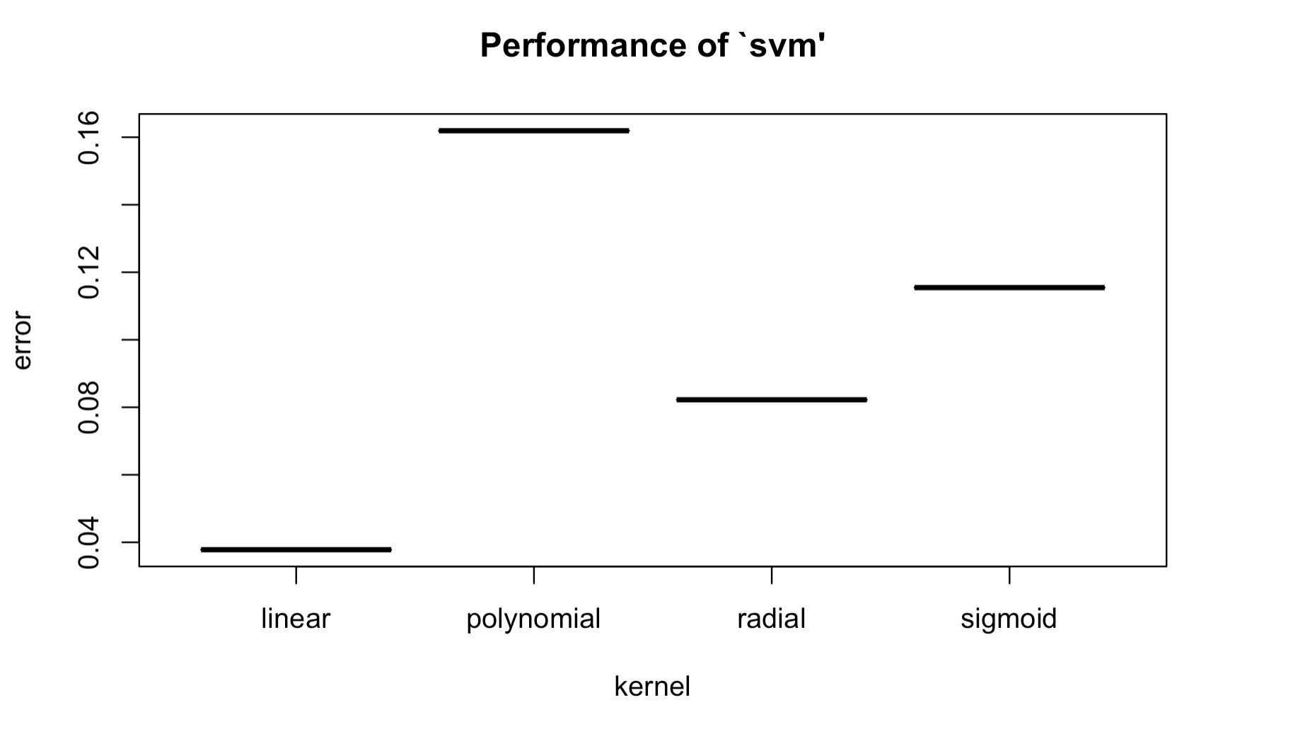
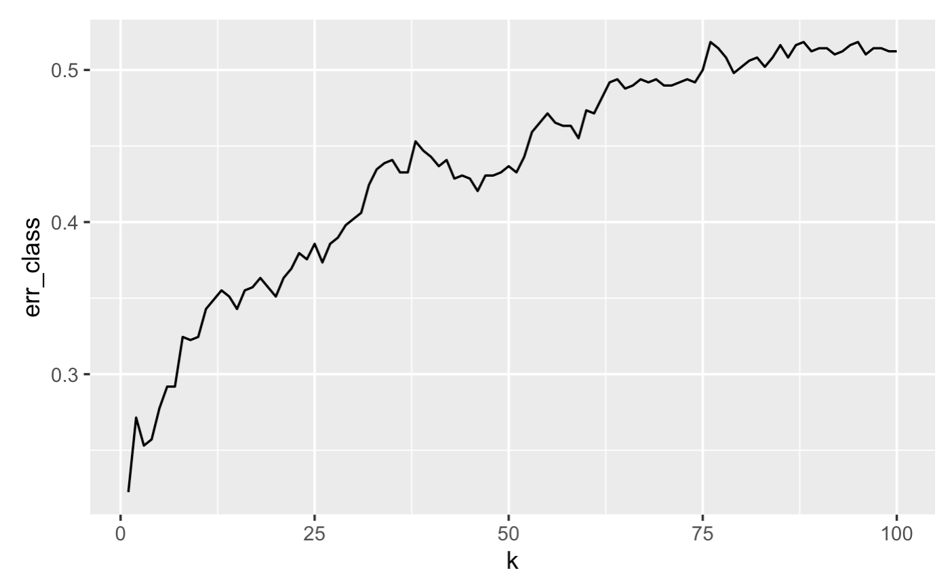
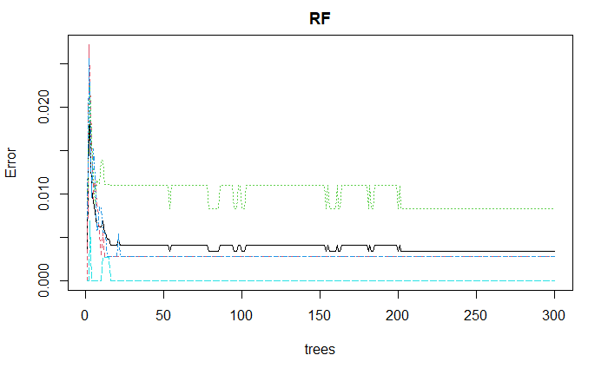
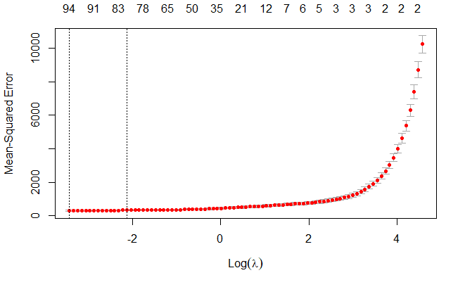
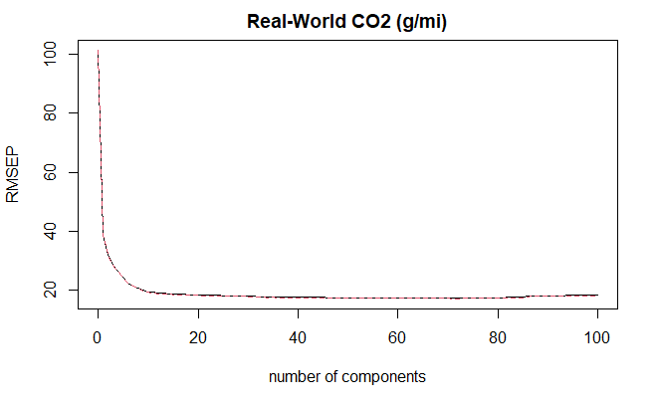

Predicting Automobile Emission Levels with
Machine Learning
Classification | Support Vector Machine Linear, Classification Error: 3.78%
KNN Best K = 1 neighbor Classification Error: 22.25% | Random Forest Best m = 64 (300 trees) Classification Error: 0.82%
Bootstrap 99,999 samples 106 predictors MSEP of 408.9 | Regression
Lasso 73 predictors (1 se) MSEP of 475.44 | Partial Least Squares 56 components MSEP of 404.7
Results/Implications
For classification, Random Forest performed the best at predicting the quartile of emissions an automobile would be in.
PLSR was the best performing classification technique with 56 components and an MSEP of 404.7.
Potential Next Steps: Incorporate other relevant variables such as cost of car and compatible fuels.
Not enough data within the different levels for categorical variables; future attempts to apply this data to LDA/QDA might be unsuccessful.
Data on emission and fuel economy variables might be inaccurate, given that these values are collected from compliance tests in which manufacturers can cheat (i.e. VW in 2015).
These models can’t predict emissions for a particular automobile model, and there could be consequences if regulators tried to apply these models to predict emissions of new automobiles.
Collin Coil & Thao Huynh
Introduction/Context
Automotive industry is one of the major contributors to climate change and most of the environmental impact associated with motor vehicles occurs when they are used.
What factors affect a vehicle’s real-world carbon dioxide emissions? Can we classify level of emissions based on vehicle type, fuel efficiency, engine characteristics, and other factors?
Finding a fuel-efficient and low carbon emission vehicle would ease the strain the automotive industry inflict on the planet.
Approach
For classification to predict emission levels, we tested KNN, Support Vector Machine, and Random Forest.
For regression to predict emissions, we tested bootstrapping, Lasso regression, and partial least squares.
We trained these models with 75% of the data and tested with 25%.
Assumptions/Limitations
Data for potential predictor variables for classification was quite small, so we had to create our own categorical response variables.
Major methodological changes were propagated backwards through the historical database in order to maintain the integrity of long-term trends.
Multicollinearity is an assumption that must be checked for future works and in this case was checked.
Acknowledgments
Dr. Richard Ressler for teaching Stat 427
Data
The data for this project was the Automotive Trends data set from the EPA.
After cleaning, there were 1958 observations.
This is aggregated data, so we only know average emissions for a manufacturer’s car by regulatory class.
Primary References
Data is accessible at: https://www.epa.gov/automotive-trends/explore-automotive-trends-data#DetailedData
Notes:
““executive” summary that succinctly describes the most important findings and recommendations in a manner that entices the viewer/reader to engage more with your poster or report?
“Identify the stakeholders in the analysis and its outcomes. Assess any ethical implications of the data (collection methods, sources, structure) or the choices made in the analysis (grouping, selection, etc.) or concerns for implementation.”

